Slide 1
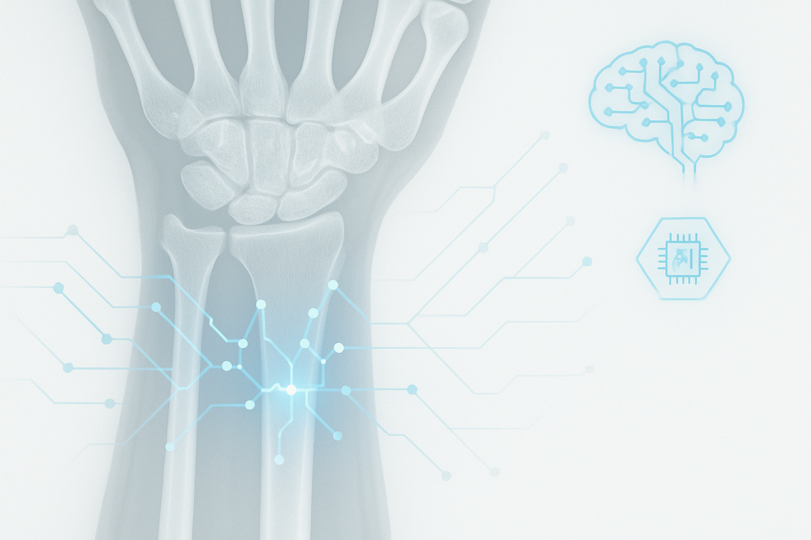
GROUP 9
WRIST FRACTURE DETECTION USING CONVOLUTIONAL NEURAL NETWORKS
SAT 5114
ARTIFICIAL INTELLIGENCE IN HEEALTHCARE
PRESENTED BY:
CLETUS NGWERUME & FREDERICK DAMPTEY

Slide 2

INTRODUCTION
A Computer-Aided Diagnostic system for accurate and early wrist fracture detection using deep learning models
Wrist fractures are among the most common orthopedic injuries, especially in elderly and trauma patients.
Wrist joint comprises multiple small bones and articulations, making diagnosis complex.
Plain X-rays are cost-effective and widely used but require expert interpretation.
Issue: Subtle fractures are often missed, especially in understaffed or rural healthcare settings.
AI can assist clinicians by providing rapid, consistent interpretations — reducing diagnosis time and improving outcomes.

Slide 3
PROBLEM STATEMENT & OBJECTIVES
Problem: Human expert readers like radiologists and orthopedic surgeons are not always reachable to interpret x-rays. Even when available, subtle fractures may easily be missed, resulting in misdiagnosis. This is compounded by variability in interpretation.
Project Goal: Develop a deep learning-based Computer-Aided Diagnostic (CAD) system using CNNs.
Objectives:
Acquire, load, preprocess and classify wrist X-ray images (fracture vs. normal).
Train ResNet50 and EfficientNetB0 using transfer learning.
Evaluate performance using accuracy, PrecisioF1-score, AUC.
Use Grad-CAM to visualize and localize fractures on X-rays.

Slide 4
LITERATURE REVIEW
CNNs in radiography have shown strong performance in prior studies.
Suen et al. (2024): AI system achieved 92% sensitivity, 89% specificity in wrist fracture detection.
Husarek et al. (2024): Meta-analysis found CNNs achieved pooled sensitivity/specificity ~90%.
Yee et al. (2019): Inception-ResNet v2 with Faster R-CNN gave an AUC of 0.895.

Slide 5
DATASET
Source: Kaggle (Better Mura)
Subset: Wrist-only X-rays
Size: Over 3000 images
Views: Includes PA, AP, and lateral projections
Challenges:
Class imbalance (more normal cases)
Variation in image quality and resolution

Slide 6
PREPROCESSING PIPELINE
Label Encoding
converting labels 0 and 1 for negative and positive respectively
Normalization
Pixel intensities scaled to [0, 1]
Splitting
80% training,
20% validation,
with stratified sampling to maintain class distribution
Resizing
Standardized to 224×224 for model input
Augmentation
Rotation, flipping
Contrast normalization
Gaussian noise
Modelling
Resnet50 and
EfficientNetB0

Slide 7
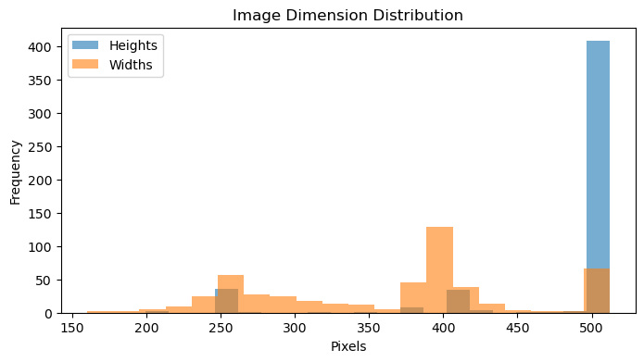
DIMENSION DISTRIBUTION IN ORIGINAL DATASET

Slide 8
MODEL ARCHITECTURE
COMMON HYPERPARAMETERS
RESNET50 ARCHITECTURE
EFFICIENTNETB0 ARCHITECTURE
Dense units: 64
Dropout rate: 0.3
Learning rate: 1e-4
Epochs: 25
Class weights: {0: 1.0, 1: 1.5}
to address class imbalance (fracture = minority)
Base: ResNet50 pretrained on ImageNet
Top Layers:
Global Average Pooling
Dense (64 units, ReLU)
Dropout (rate = 0.3)
Output: Dense(1, sigmoid) for binary classification
Fine-tuning: Last 15 layers unfrozen
Optimizer: Adam, Loss: binary_crossentropy, Metric: accuracy
Base: EfficientNetB0 pretrained on ImageNet
Top Layers:
Global Average Pooling
Dense (64 units, ReLU)
Dropout (rate = 0.3)
Output: Dense(1, sigmoid)
Fine-tuning: Last 15 layers unfrozen
Optimizer: Adam, Loss: binary_crossentropy, Metric: accuracy
CALLBACKS
EarlyStopping: Monitors val_loss, restores best weights if no improvement after 5 epochs
ReduceLROnPlateau: Reduces learning rate by factor 0.2 if no improvement in 2 epochs (min LR = 1e-6)

Slide 9
PERFORMANCE COMPARISON
Metric | ResNet50 | EfficientNetB0
Accuracy | 92% | 88%
Precision (Positive) | 93% | 90%
Recall (Sensitivity) | 87% | 81%
Specificity | 96% | 93%
F1-Score (Positive) | 0.90 | 0.85
AUC-ROC Score | 0.9146 | 0.8707
Interpretation:
ResNet50 demonstrates stronger overall performance, especially in F1-score and AUC and Specificity.
EfficientNetB0 offers slightly faster training with comparable precision.
Both models perform well with literature benchmarks, where AUC typically ranges from 0.87 to 0.93 (Rajpurkar et al., 2017).

Slide 10
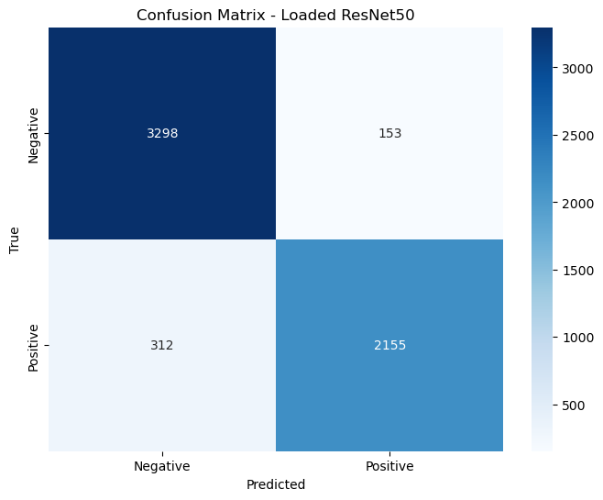
CONFUSION MATRIX
RESNET50 MODEL

Slide 11
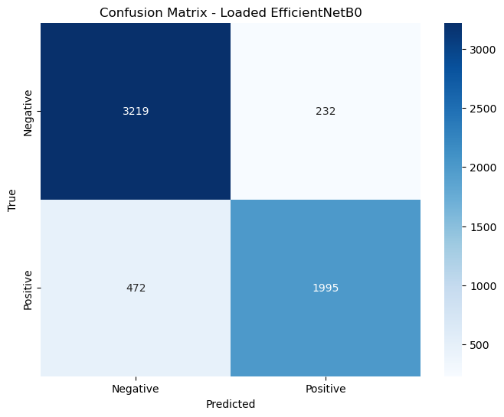
CONFUSION MATRIX
EFFICIENTNETB0
MODEL

Slide 12
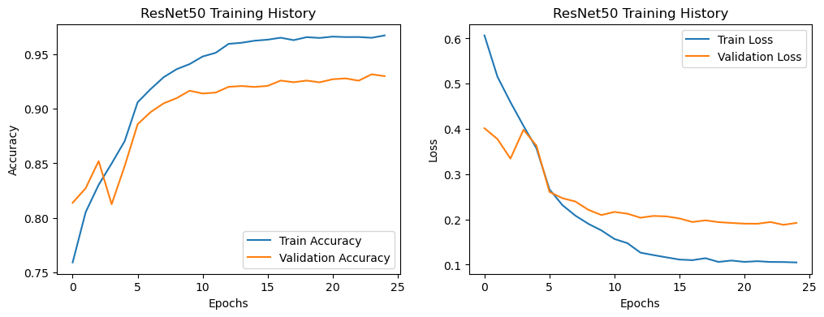
LOSS ERROR GRAGH RESNET50

Slide 13
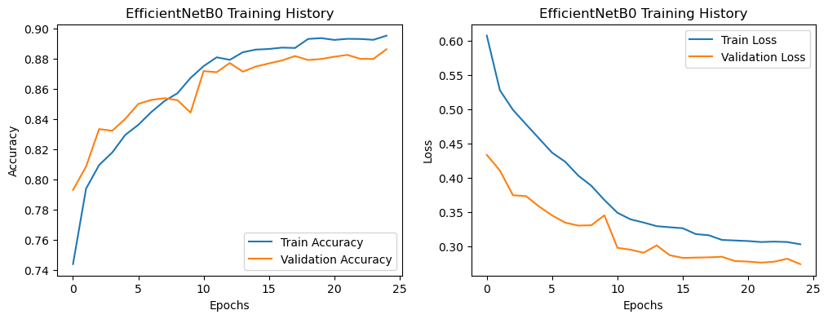
LOSS ERROR EFFICIENTNETB0GRAGH

Slide 14
Discussion
Both ResNet50 and EfficientNetB0 showed high effectiveness in binary wrist fracture classification using X-ray images from the MURA dataset.
ResNet50 outperformed across most metrics:
Accuracy: 92%, Sensitivity: 87%, Specificity: 96%, AUC: 0.9146
EfficientNetB0 maintained high precision (90%), offering a lightweight and fast alternative suitable for real-time or mobile deployments.
These results align well with literature (AUC range: 0.87–0.93), supporting their validity.
Limitations
Grad-CAM failed to produce meaningful fracture localization in several cases due to:
Subtlety of fractures: Many fractures lack distinct visual boundaries that Grad-CAM can highlight.
Small lesion size: Grad-CAM’s heatmap resolution is coarse, making it less suitable for fine-grained features like micro-fractures.
Model focus: The model may have learned spurious correlations (e.g., image artifacts or positioning), diverting attention from the actual fracture site.
As a result, Grad-CAM interpretability was limited and inconsistent, and not reliable for clinical localization of wrist fractures in our setting
DISCUSSION &LIMITATIONS

Slide 15
CONCLUSION &
FUTURE WORK
Conclusion
CNN-based models like ResNet50 and EfficientNetB0 provide high-accuracy, automated wrist fracture detection, with strong diagnostic potential.
These tools can assist healthcare providers, especially in low-resource or high-demand environments, by improving diagnostic accuracy and reducing radiology workload.
Future work
Train on datasets with detailed annotations or segmentation masks to guide model attention.
Incorporate higher-quality, clinically annotated datasets (e.g., bounding box or pixel-level labels).
Use multi-view X-ray data to improve spatial understanding.
Explore Vision Transformers (ViTs) or multi-branch CNNs for better spatial feature capture.
Apply ensemble learning to integrate multiple model decisions for robust performance.
Validate model performance with radiologist-labeled external data.
Assess integration potential into PACS systems or radiology workflows in clinical environments

Slide 16

THANK YOU
Deep learning models like ResNet50 and EfficientNetB0 can serve as effective diagnostic assistants, offering real-time and accurate wrist fracture detection. These models show strong potential for integration into clinical triage systems, especially in environments with limited radiological expertise
QUESTIONS?

